Slide 1
Presented By
Abhishek Mundada(Exam Seat No.T9168)
Shivam Ambadkar(Exam Seat No. T9173)

Slide 2




Slide 3
ABSTRACT
The basic purpose of the project “Shopping Center Management System” is to develop software that keeps record of the customer purchasing items and to give satisfactory services to them.
With this project we can maintain various records and perform operations on them.
We can keep record of the items and products and their history . This project will help to ease the workload of the employees working in the Shop and will also execute jobs which used to be done on paper in an errorless manner.
With the help of this project, we can thus evaluate the total item sold by the Shop. It thus decreases the tiresomeness of the job to a great extent. This software increases the efficiency of the operations performed in an Home Aplliance Shop.

Slide 4
PROBLEM STATEMENT
To develop a software for managing the operations of an Shopping Center .
This system includes the following:
Collection of customer information which includes his personal details (if any).
Information of different types of Essentials(ex. T-shirt, Jeans).
Collection of different types of Rates for different Product and keeping a log of the Products sold or purchased by user.
Maintenance and updation of the rates, staff and customer database from time to time
Management of staff . Keeping a log of the sales done by the staff members.
Maintain record of the supplier.

Slide 5

To develop a simple software that keeps record of the
customers purchasing from the shop and to give satisfactory
services to them.
To ease the workload which is used to be done on paper in an errorless manner.
Collection of customer’s information which includes their
personal details .
Maintains and updates the customers and staff databasetime to time and also keeps the track of products.

Slide 6
INTRODUCTION
The Administrator has to fill in different information from time to time for each customer. The administrator has to perform various complex tasks for maintaining the whole database. He has to go through all records to maintain and arrange them properly.
The system being designed is administrator-oriented. It simplifies the identification information collection from the customer and automates the process wherever possible.

Slide 7

Purpose Of Project
Software Requirements
Hardware Requirements
E-R Diagram
Flow Diagram
Contents of the Project
Closing Thoughts

Slide 8

Microsoft® Visual Basic 8.2
MySQL Database 5.1.48
Microsoft® Windows® XP
macOS High Sierra 10.13.2
NetBeans IDE 8.0.1

Slide 9

Intel Pentium-based processor (Minimum 1.7GHz Pentium 4 Processor)
Minimum 40GB HDD
Minimum 256MB RAM
Monitor
Keyboard
Mouse

Slide 10

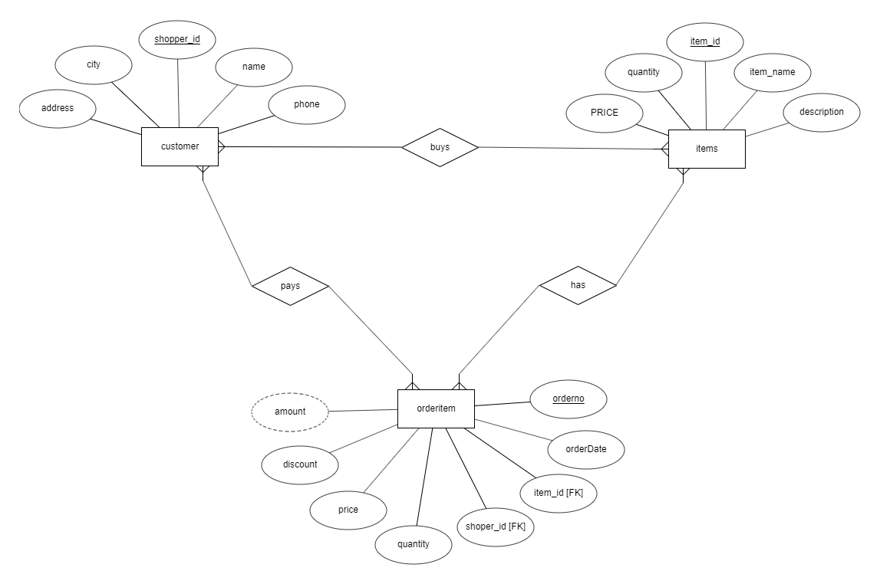

Slide 11

FEATURES:
Customer Record
Employee Record
Sales Record
Purchase Record
Products Record
Suppliers Record

Slide 12

DIFFERENT TYPES OF Record
Bat
Perk
T-Shirt
Jeans
Headset
Customer Record
Product Record
Orders Record

Slide 13
ADMINISTRATOR CONSOLE
Features and Responsibilities:
To add or remove any customer from the record.
To monitor the staff activities and maintain their database.
To generate various reports for the sales and purchase record.
To Modify the staff and customer record.

Slide 14

Thus, the use of this software facilitates ease of task, servicing and management for the administrator. It provides help to keep the customer’s record and various product’s record.

Slide 15


